Slide 1


UNIVERSITY INSTITUTE OF ENGINEERING
Bachelor of Engineering (Computer Science & Engineering)
Operating System (CST-328)
Subject Coordinator: Er. Puneet kaur(E6913)
DISCOVER . LEARN . EMPOWER

Slide 2
Lecture 5 Process Concepts
Process
Process State
Process Control Block
Remote Procedure Calls

Slide 3
The process : Definitions
A program in Execution.
An asynchronous activity.
The 'animated spirit' of a procedure in execution.
The entity to which processors are assigned.
The 'dispatchable' unit.

Slide 4
The process state consists of :
Code for the program.
Program's static data.
Program's dynamic data.
Program's procedure call stack.
Contents of general purpose registers.
Contents of program counter (PC)
Contents of program status word (PSW).
Operating Systems resource in use.

Slide 5
Process States
New State: The process being created.
Running State: process actually using the CPU at that particular instance.
Blocked (or waiting) State: A process is said to be blocked if it is waiting for some event to happen such that as an I/O completion before it can proceed.
Ready State: A process is said to be ready if it is waiting to be assigned to a processor.
Terminated state: The process has finished execution.

Slide 6
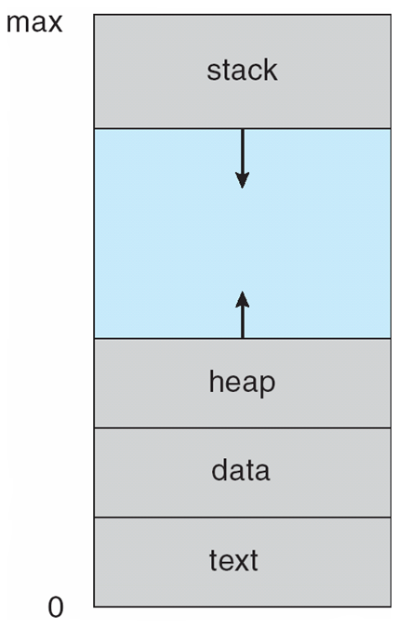
Process in Memory

Slide 7
Process Control Block
A process control block (PCB) contains information about the process, i.e. registers, quantum, priority, etc. The process table is an array of PCB’s, that means logically contains a PCB for all of the current processes in the system.

Slide 8
Process Table Contains
Pointer
Process state
Process number
Program counter
Register
Memory limits
Open files list
Miscellaneous accounting and status data

Slide 9
Remote Procedure Calls
A remote procedure call is an inter-process communication technique that is used for client-server based applications. It is also known as a subroutine call or a function call.
A client has a request message that the RPC translates and sends to the server.
This request may be a procedure or a function call to a remote server
When the server receives the request, it sends the required response back to the client. The client is blocked while the server is processing the call and only resumed execution after the server is finished.

Slide 10
Sequences of events in a remote procedure call
The client stub is called by the client.
The client stub makes a system call to send the message to the server and puts the parameters in the message.
The message is sent from the client to the server by the client’s operating system.
The message is passed to the server stub by the server operating system.
The parameters are removed from the message by the server stub.
Then, the server procedure is called by the server stub.

Slide 11
Advantages of Remote Procedure Call
Remote procedure calls support process oriented and thread oriented models.
The internal message passing mechanism of RPC is hidden from the user.
The effort to re-write and re-develop the code is minimum in remote procedure calls.
Remote procedure calls can be used in distributed environment as well as the local environment.
Many of the protocol layers are omitted by RPC to improve performance.

Slide 12
Disadvantages of Remote Procedure Call
The remote procedure call is a concept that can be implemented in different ways. It is not a standard.
There is no flexibility in RPC for hardware architecture. It is only interaction based.
There is an increase in costs because of remote procedure call.

Slide 13
Conclusion
This lecture enables students to understand what is a process, process states, process table, process control block, remote procedure calls its advantages and disadvantages.

Slide 14
References
https://www.includehelp.com/c-programming-questions/
https://www.studytonight.com/operating-system/
https://computing.llnl.gov/tutorials/
https://www.tutorialspoint.com/operating_system/index.htm#:~:text=An%20operating%20system%20(OS)%20is,software%20in%20a%20computer%20system.
https://www.javatpoint.com/os-tutorial
https://www.guru99.com/operating-system-tutorial.html
https://www.geeksforgeeks.org/operating-systems/

